Slide 1
Emergency Vehicle Dispatching System
Vladislav Dubrovenski
CS 404

Slide 2
Dijkstra’s Algorithm
This algorithm is used for finding the shortest paths between nodes in connected graph(there is a path to each node from every node)
It works as follows:
Setting start node distance to 0 and others to infinity
Creating a heap node for each vertex which was not visited yet
While minheap is not empty:
Extract the min node from the heap, and add it to Shortest Path Tree of visited nodes
Decrease distance: For adjacent vertex v, if v is not in SPT[] and distance[v] > distance[u] + edge u-v weight then update distance[v] = distance[u] + edge u-v weight(Relax Function, trying to lower the cost of getting from one vertex to another)

Slide 3
Three ways of using MinHeaps as a priority queue (Big O)
Binary Heap(heapq)
O((E+V)logV)
Fibonacci Heap(fibheap)
O(E+(VlogV))
Binomial Heap(binomial)
O(E+(VlogV))

Slide 4
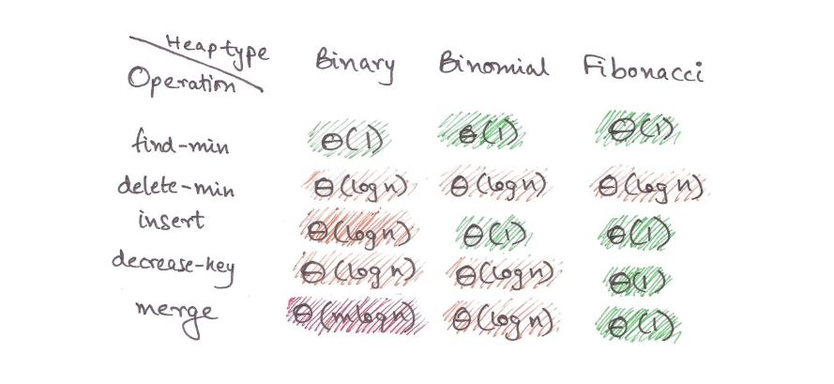
Time Complexities of Operations
http://algosaur.us/binomial-heaps/

Slide 5
Approach to Solve the Problem
Created 3 datasets: dists, requests, vehicles
Vehicles consist of id, type, zip, free parameters
Requests consist of id, type, zip, vehicles, dist parameters
Dists consist of zip1, zip2, dist
Added all vertices and edges to the graph by iterating through dists
Processed requests one by one
Get the vehicles of requested zip and type
Set all distances to infinity
Pass the requested vertex to Dijkstra’s and calculate the shortest distance to every node
Assign calculated distances to each available vehicle
Sort the free vehicles by their distance
Set the free parameter of the vehicle corresponding to the first one to False
Assign vehicle and distance to the request and print it(as well as write into the file)

Slide 6
Expectations vs Reality
I expected Fibonacci Heap and Binomial Heap work faster than Binary heap due to a better Big O
However, in reality they all worked very fast on the small dataset
Maybe in the future I will create a connected graph that will make sense and will be big enough to see the difference of three data structures
The measured time are:
Binary: 0.02996
Fibonacci: 0.05183
Binomial: 0.04089
Also, heapq(binary) is using c-implementation of the library so I think that might affect performance as well

Slide 7
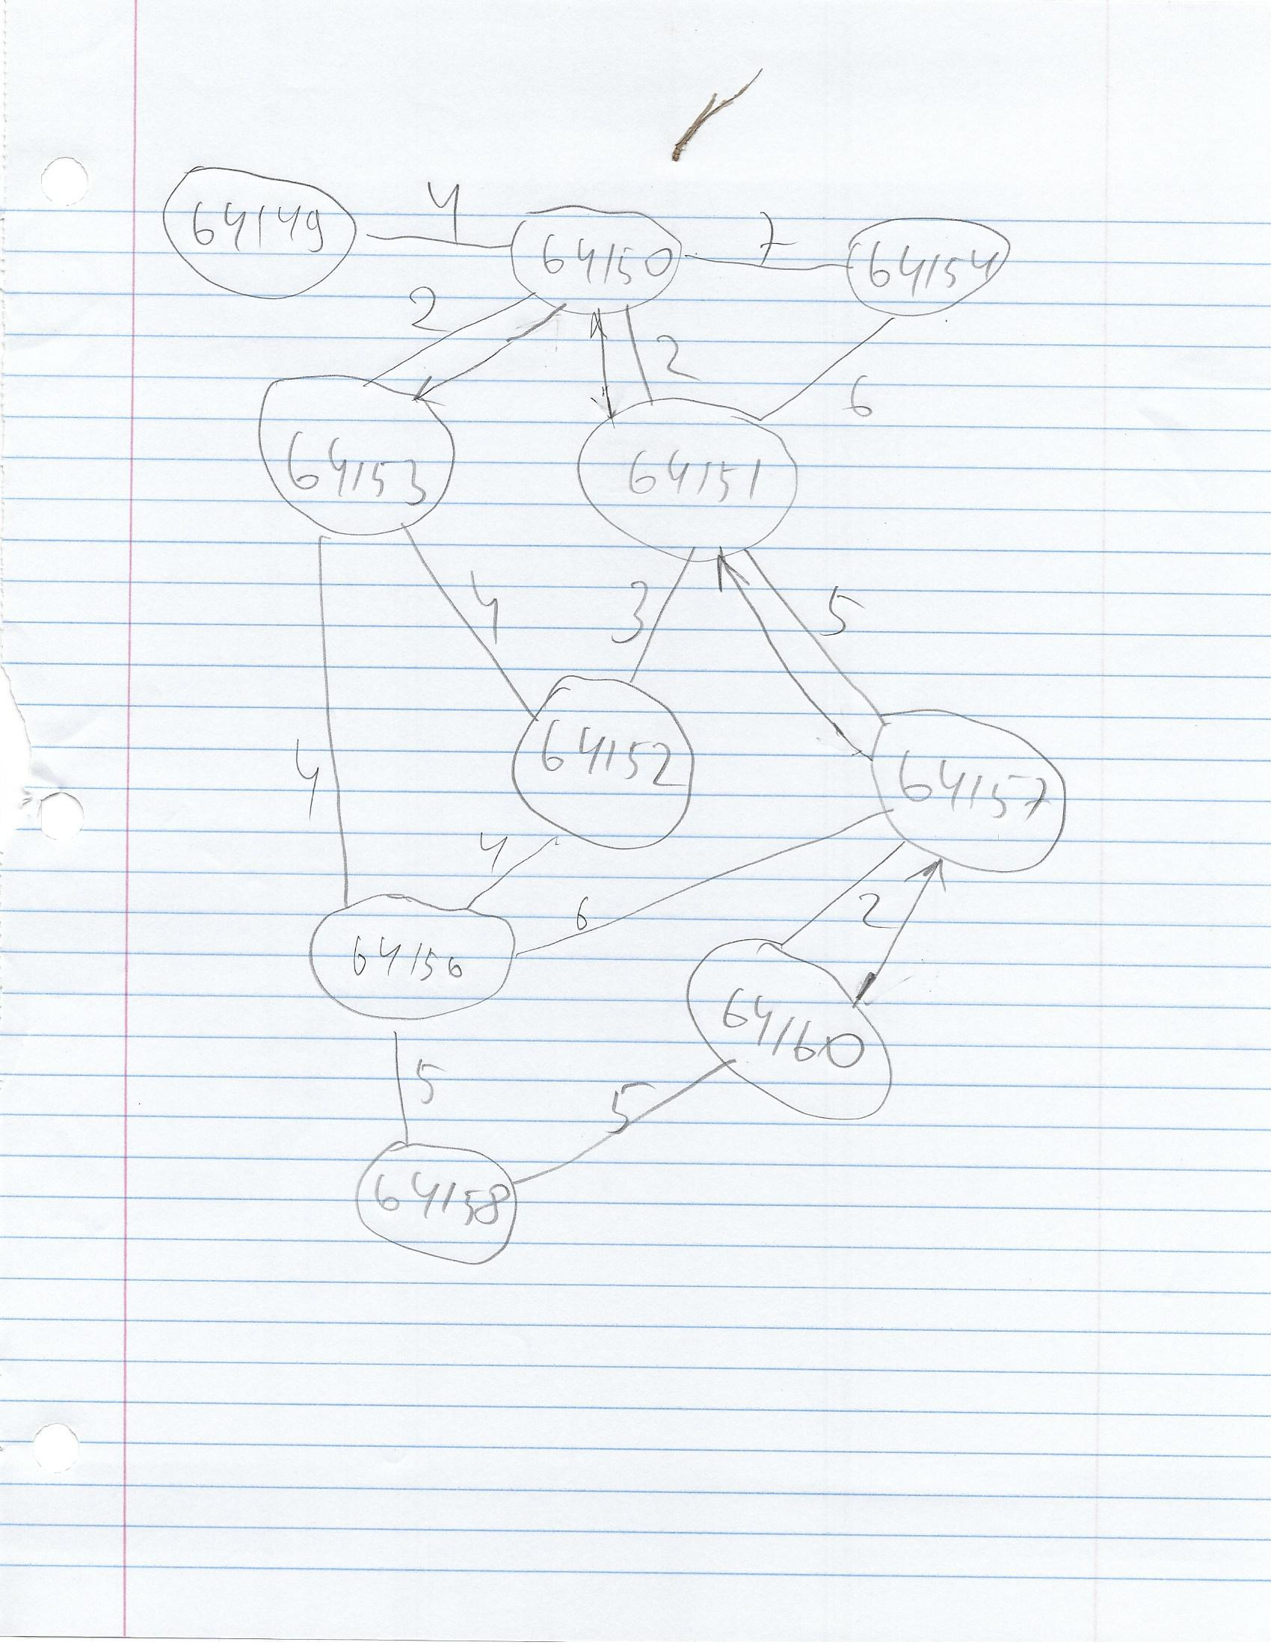

Slide 8
References
https://github.com/brandenburg/binomial-heaps/blob/master/bh.py
https://pypi.org/project/fibheap/
https://stackoverflow.com/questions/6215485/what-is-the-difference-between-binary-heaps-and-binomial-heaps
https://github.com/arlieu/interview-guide/blob/master/algorithms/graphing/dynamic_programming/dijkstra.py
https://github.com/abhiram383/Daaproject/blob/master/DAA/data.json
http://www-inst.eecs.berkeley.edu/~cs61bl/r//cur/graphs/dijkstra-algorithm-runtime.html?topic=lab24.topic&step=4&course=
http://algosaur.us/binomial-heaps/
https://algorithms.tutorialhorizon.com/dijkstras-shortest-path-algorithm-spt-adjacency-list-and-min-heap-java-implementation/

